Slide 1
Monitoring and Logging Setup (AWS CloudWatch)

Slide 2
Introduction
Amazon CloudWatch is a service used for monitoring and observing resources in real-time,built for DevOps engineers, developers, site reliability engineers (SREs), and IT managers.
CloudWatch provides users with data and actionable insights to monitor their respective applications, stimulate system-wide performance changes, and optimize resource utilization.
CloudWatch collects monitoring and operational data in the form of logs, metrics, and events, providing its users with an aggregated view of AWS resources, applications, and services that run on AWS.
The CloudWatch can also be used to detect anomalous behavior in the environments, set warnings and alarms, visualize logs and metrics side by side, take
automated actions, and troubleshoot issues.

Slide 3
What is Amazon CloudWatch?
Amazon CloudWatch is a monitoring and observability service provided by Amazon Web
Services (AWS) that enables users to collect and track metrics, monitor log files, set alarms,
and automatically react to changes in AWS resources. It helps users gain insights into the
operational health, performance, and resource utilization of their AWS infrastructure and
applications.
Why Amazon CloudWatch?
Amazon Cloud Watch is a monitoring service offered by Amazon Web Services to monitor
applications like the following.
• Performance.
• Health of the application.
• Monitors the resource use, etc.
You can set the alarm to the to the resource use of the applications when the limits are
exceeded then you will get the notification to the mail automatically.

Slide 4
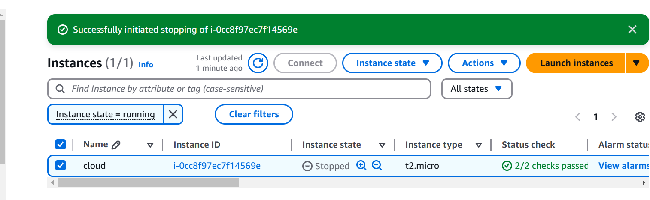
Instance creation
Creating an linux instance

Slide 5
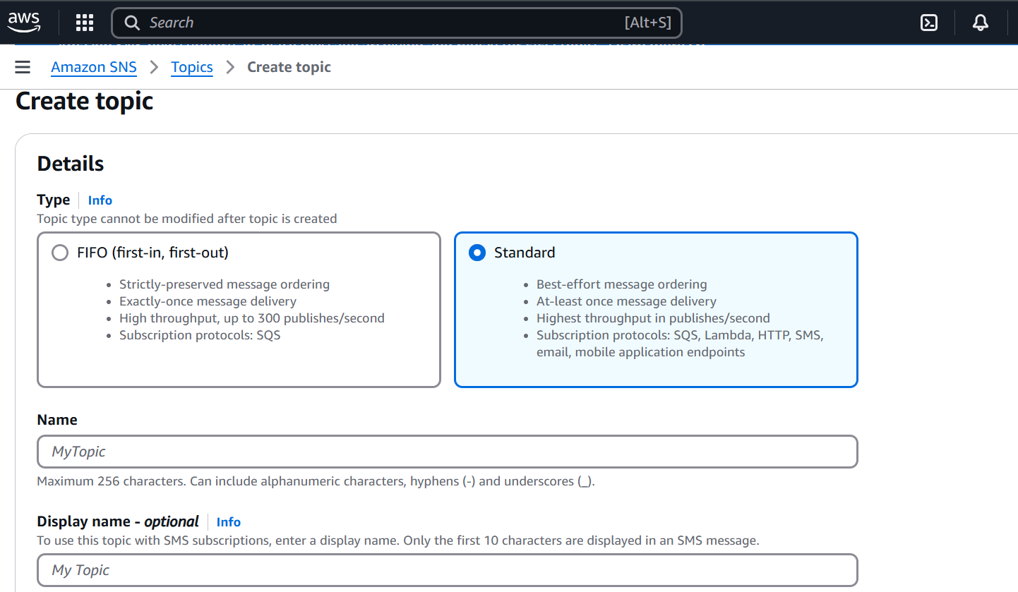
Creating topic in SNS
Select standard, give name and click on create

Slide 6
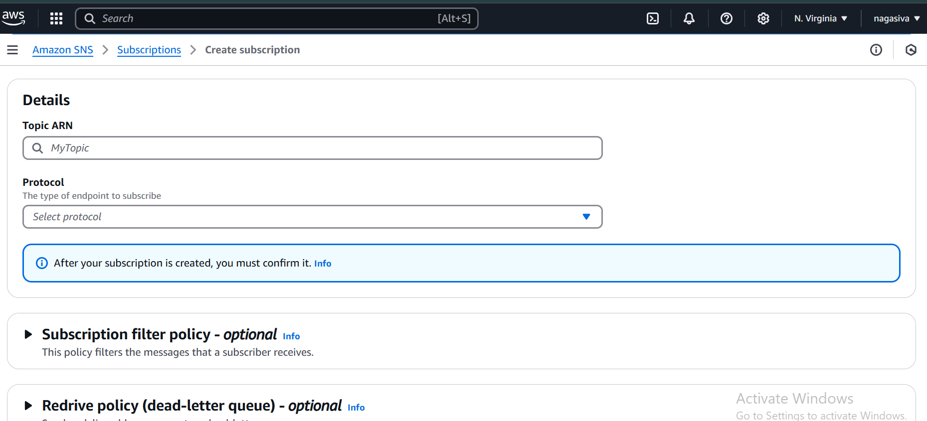
Creating subscription
give name,in protocol select email then give your email id and then click on create

Slide 7
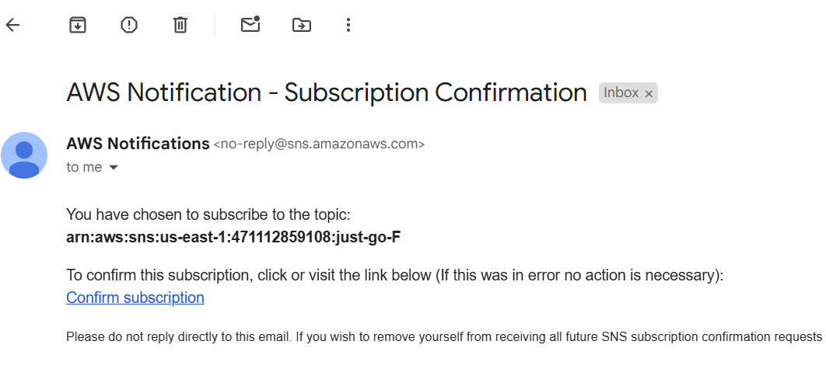
confirm subscription so we get notification when alarm triggered

Slide 8
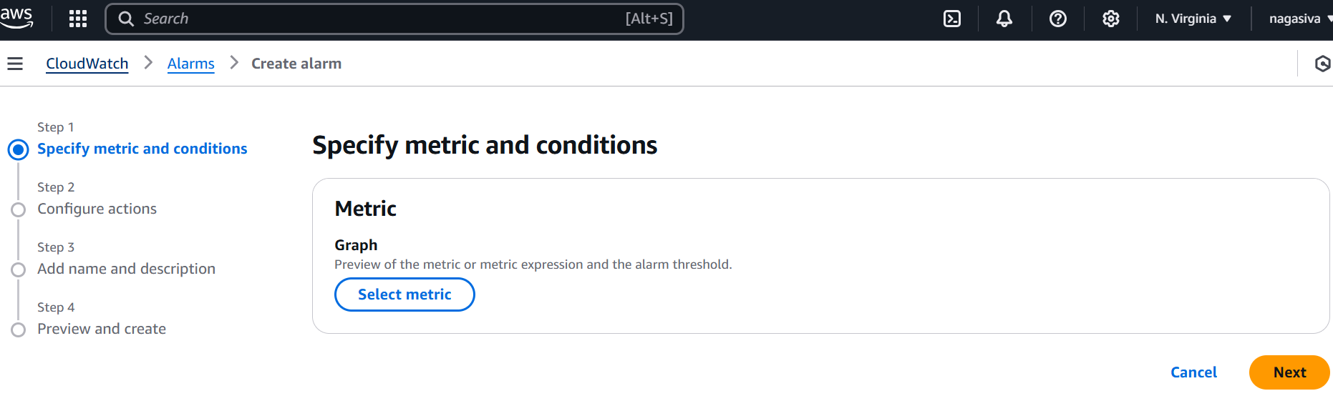
Creating Alarm in cloud Watch
Click on create alarm slect metric click on next

Slide 9
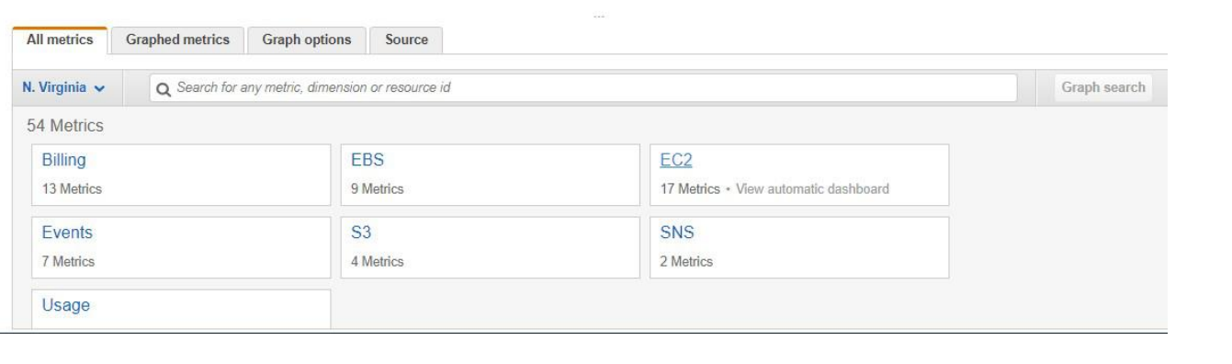
Selecting Ec2

Slide 10
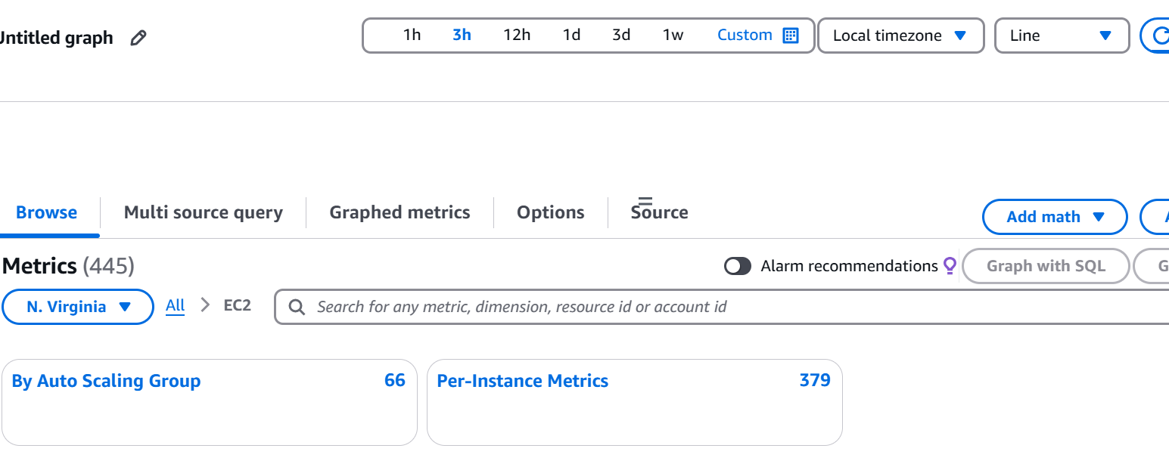
Selecting per-instance Metric

Slide 11
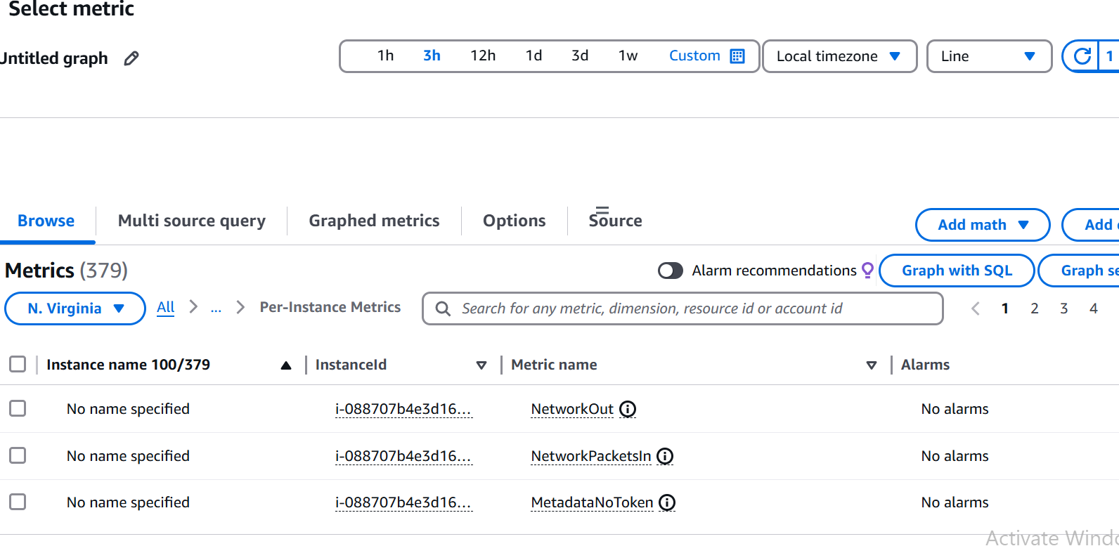
Copy instance id & give it in search bar & then select cpu utilisation

Slide 12
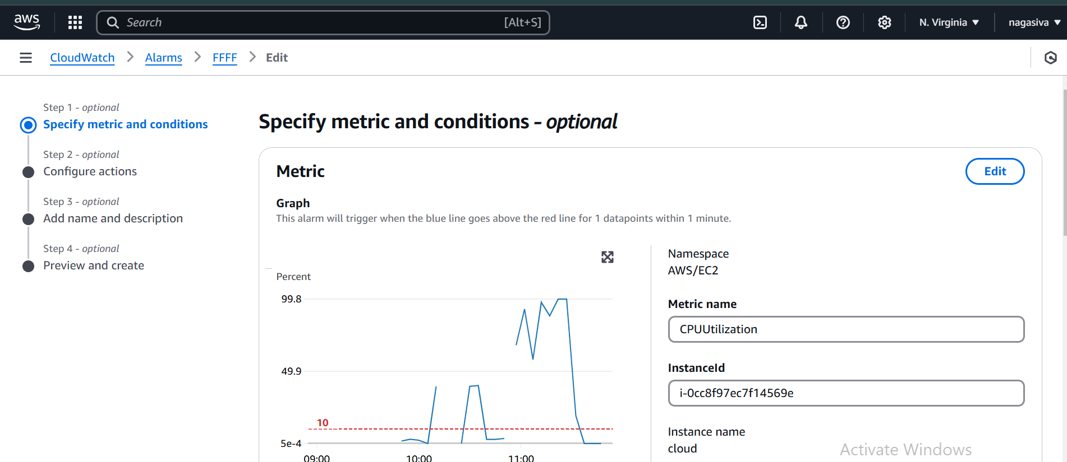
Creating Alarm in CloudWatch
give time of 1 min and Threshold value of 10 less than or equal to as shown in below slide

Slide 13
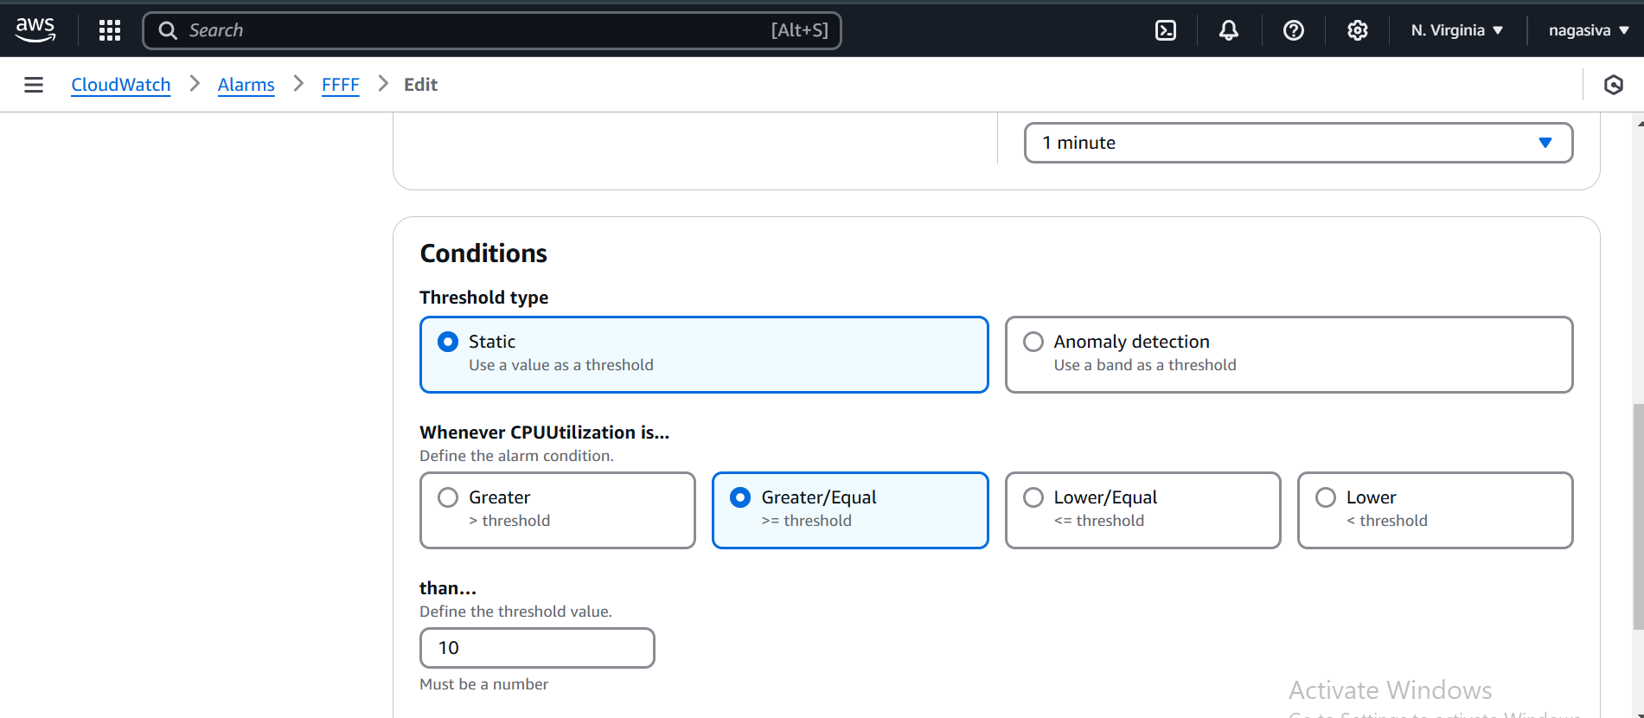

Slide 14
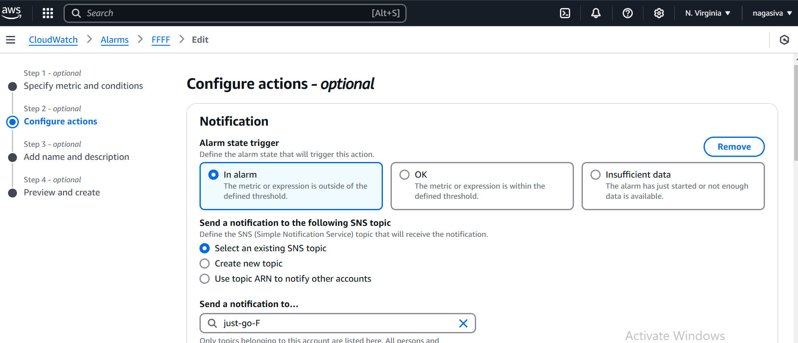
Select sns created here

Slide 15
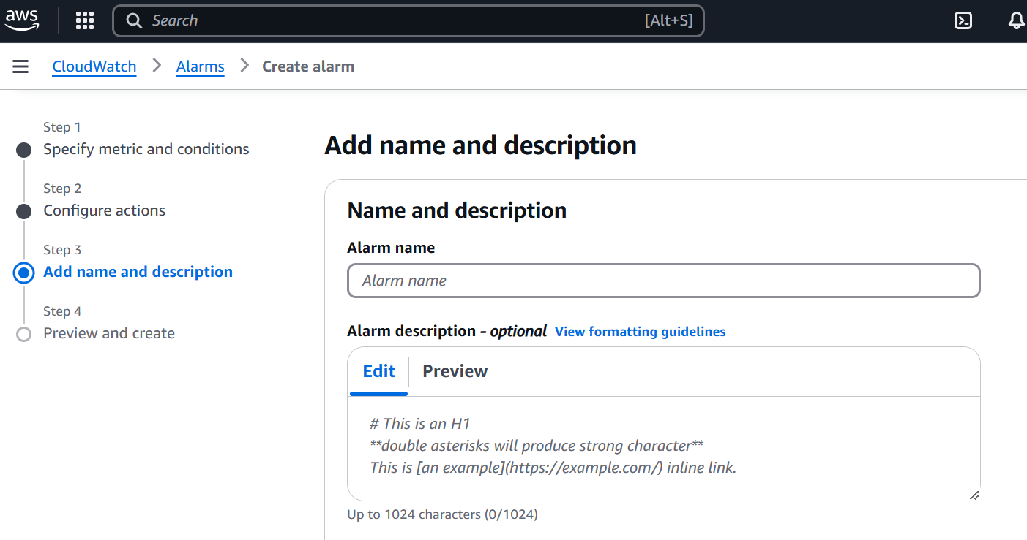
give name & text then click on next

Slide 16
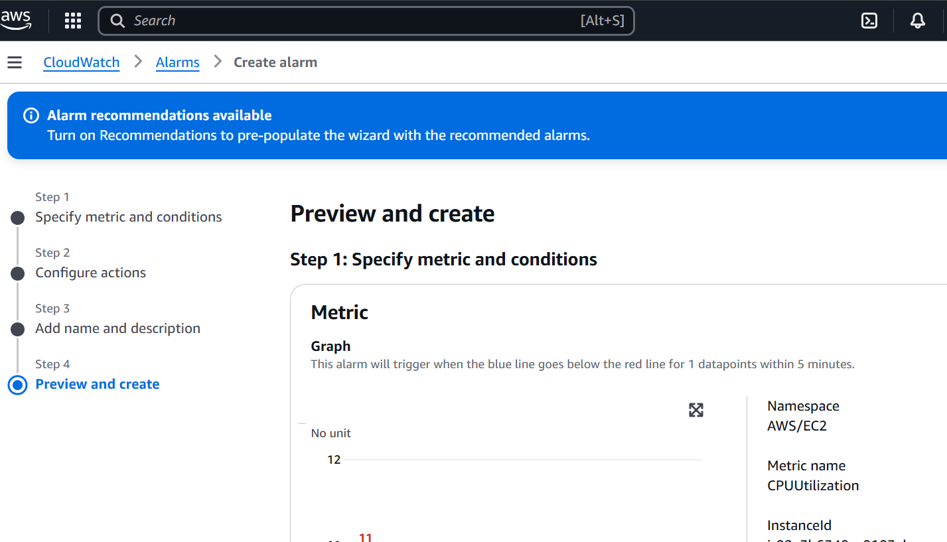
click on create alarm

Slide 17
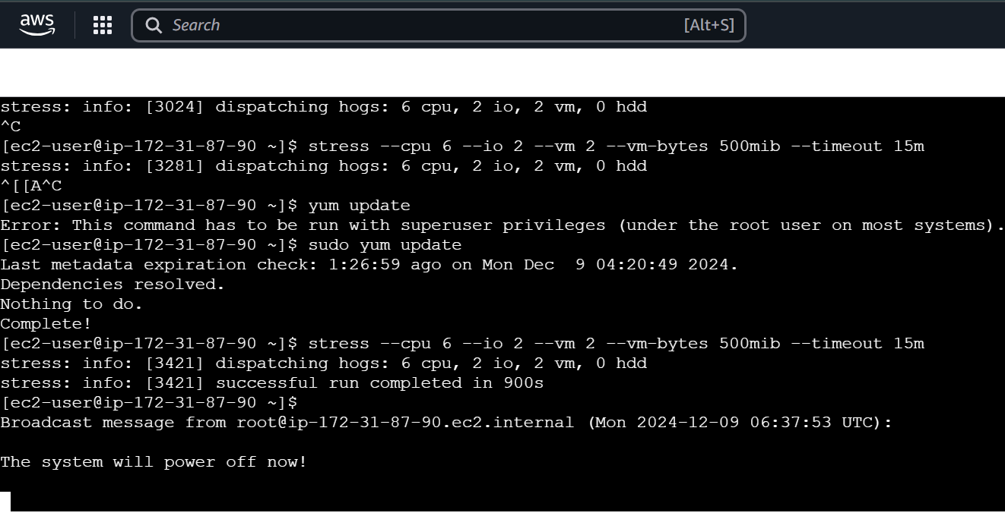
Appling stress for giving load
linux : sudo dnf install stress
U can coustomise how u want :
stress --cpu 4 --io 2 --vm 2 --vm-bytes 500mib --timeout 15m

Slide 18
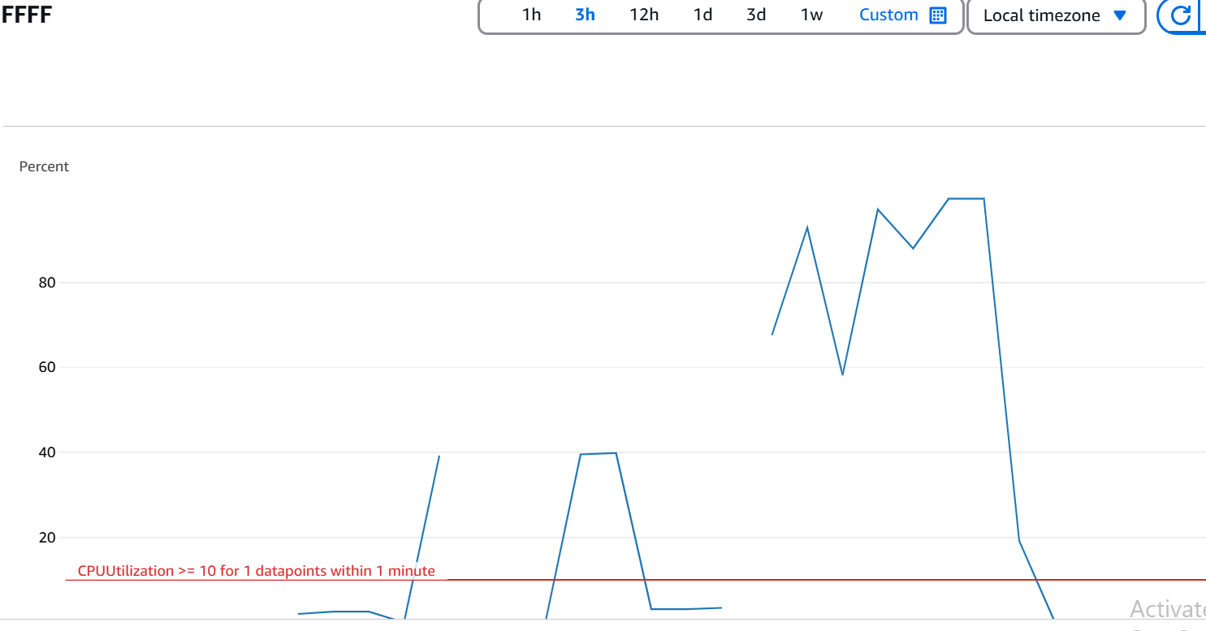
we can see graph crossed threshold value 10

Slide 19
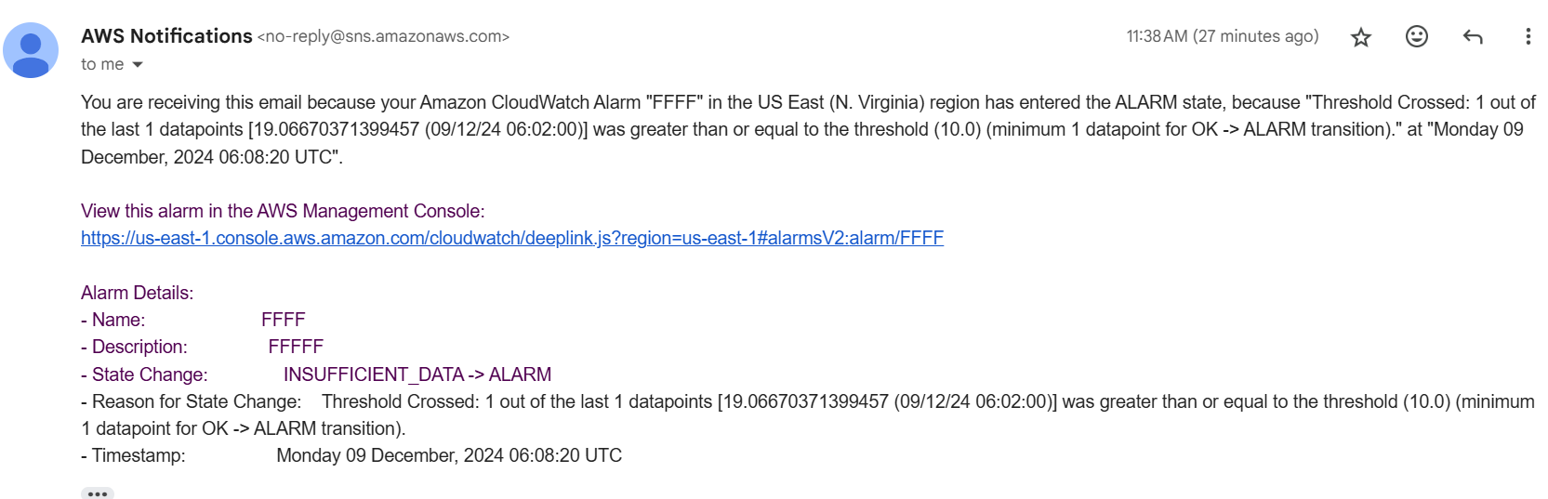
This is the mail we get after alarm triggered after applying stress

Slide 20
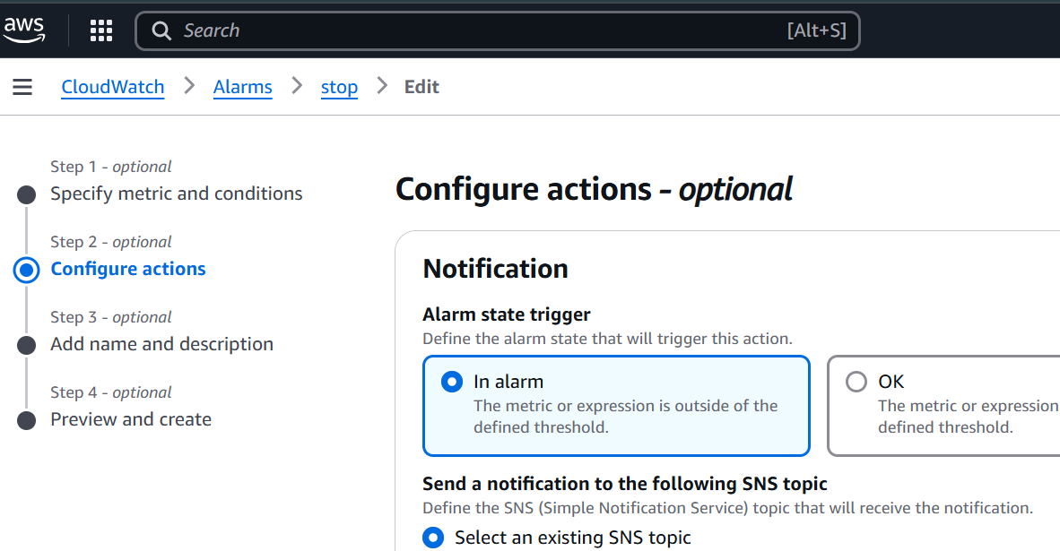
Another method in cloudwatch with Ec2 action

Slide 21
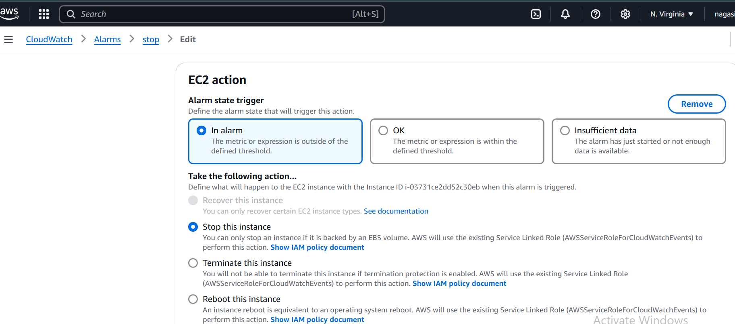
Instance will be stopped if alaram is triggered

Slide 22
Here we can see the system will power off now so Ec2 got stopped

Slide 23
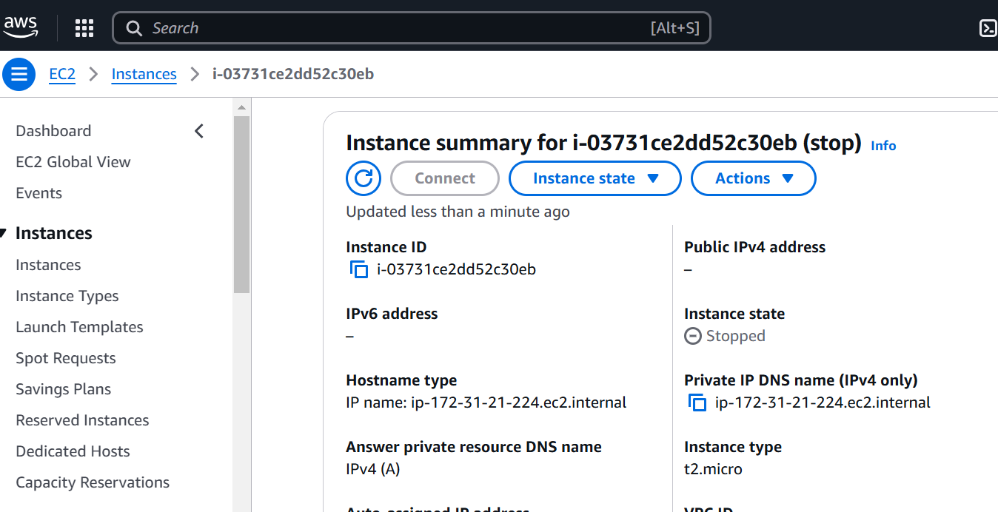
If we start instance also again same result after time of 1min we fixed

Slide 24
Conclusion:
Amazon CloudWatch is a powerful monitoring service for AWS resources and applications, providing real-time metrics, logs, and alarms. It helps users track performance, troubleshoot issues, and optimize resource usage. CloudWatch enables automated responses to system changes with custom metrics and alarms. It integrates seamlessly with other AWS services, offering centralized monitoring. Overall, it is an essential tool for maintaining the health and performance of cloud-based applications and infrastructure.

Slide 25



